Slide 1
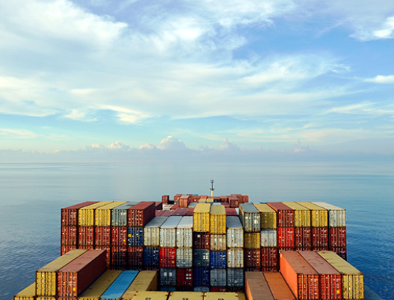
Research on Ports Sector of India.

Slide 2
Key Ports of India -:
1. Kandla Port , Gujrat.
2. Jawaharlal Nehru Port Trust (JNPT) , Maharashtra.
3. Port of Chennai (Madras Port).
4. Mumbai Port Trust .
5. Syama Prasad Mookerjee Port (Port of Kolkata) .

Slide 3
Major vs Non Major Ports -:
Major ports
Major ports are included in the Union list of the Indian Constitution and are administered under the Indian Ports Act of 1908 and the Major Port Trust Act of 1963. Each major port is overseen by a Board of Trustees appointed by the Government of India. Port development, management, and operations are among their tasks.
Minor ports
Minor ports, such as those in Gujarat, Maharashtra, and Tamil Nadu, are governed by the port department or, if one exists, the State Maritime Board. State marine boards perform similar functions to port trusts and have tariff-setting authority. They also work to attract private investment through concession contracts, incentives, exclusive rights, and land acquisition.

Slide 4
Major Ports of India :-
Zone | State | Port
Eastern Coast | Tamil Nadu | Chennai
Western Coast | Kerala | Kochi (Cochin)
Eastern Coast | Tamil Nadu | Ennore
Eastern Coast | West Bengal | Kolkata (Haldia)
Western Coast | Gujarat | Kandla
Western Coast | Karnataka | Mangalore
Western Coast | Goa | Mormugao
Western Coast | Maharashtra | Mumbai Port Trust
Western Coast | Maharashtra | Jawaharlal Nehru Port Trust (JNPT) also known as Nhava Sheva, Navi Mumbai
Western Coast | Maharashtra | Vadhavan Port
Eastern Coast | Odisha | Paradip
Eastern Coast | Tamil Nadu | Tuticorin
Eastern Coast | Andhra Pradesh | Visakhapatnam

Slide 5
Minor Ports of India :-
Some of the important minor ports are:
Azhikkal Port (Mouth of Valapattanam River Kerala)
Kannur (Kerala)
Kundapur (Udupi District Karnataka)
Dahej (Gujarat)
Jafrabad (Gulf of Cambay Gujarat)
Kasaragod (Kerala)
Karaikal (Puducherry)
Gopalpur (Odisha)

Slide 6
Commodities handled by the ports :-
The ports of India handle a wide range of commodities due to the country's diverse economy and trade activities. Here are some of the major commodities handled by Indian ports:
Crude Oil and Petroleum Products: India is a significant importer of crude oil and petroleum products, and several ports handle their import and export. Ports like Mumbai, Visakhapatnam, Paradip, Chennai, and Kandla are major hubs for oil and gas shipments.
Coal: India relies heavily on coal for power generation and industrial processes. Ports like Paradip, Visakhapatnam, Kolkata, and Chennai handle large volumes of coal imports for domestic consumption.
Iron Ore and Steel: India is one of the largest producers and consumers of iron ore and steel. Ports such as Paradip, Mormugao, Mangalore, and Chennai handle iron ore exports and steel imports.
Fertilizers: India is a major consumer of fertilizers for agricultural purposes. Ports like Kandla, Mumbai, Tuticorin, and Chennai handle the import and distribution of fertilizers.
Food Grains: Indian ports handle the import and export of various food grains, including wheat, rice, pulses, and sugar. Major ports like Kandla, Mundra, Chennai, and Kolkata handle these commodities.

Slide 7
Commodities handled by the ports :-
6. Containerized Cargo: Ports in India handle a significant amount of containerized cargo, including manufactured goods, machinery, textiles, and consumer products. Major container ports include Jawaharlal Nehru Port Trust (JNPT) in Mumbai, Chennai Port, Visakhapatnam Port, and Kolkata Port.
7. Automobiles: Indian ports also handle the import and export of automobiles and automobile components. Ports such as Chennai, Mumbai, and Kandla have dedicated facilities for handling automobiles.
8. Natural Gas: With the increasing focus on clean energy, India has been importing liquefied natural gas (LNG). Ports like Dahej, Hazira, and Kochi have facilities for handling LNG shipments
9. Chemicals: Various ports in India handle the import and export of chemicals, including industrial chemicals, petrochemicals, and specialty chemicals. Ports such as Mumbai, Visakhapatnam, Kandla, and Chennai are major hubs for chemical trade.
10. Minerals and Ores: Apart from iron ore, Indian ports also handle other minerals and ores, including bauxite, copper, manganese, and zinc. Ports like Mormugao, Mangalore, and Visakhapatnam handle such shipments.

Slide 8
Corelation between GDP , Trade and Growth:-
India's maritime policy and international trade for the coming decades will depend on the success of measures such as digitization, liberalization, and public-private partnerships in the ports and shipping sector.
India's ports and shipping sector plays a key role in the country's economic development, but its progress has been slower than that of neighboring countries in Asia and the Middle East.

Slide 9
Financial Projection :-
The government has granted infrastructure status to the logistics and ports sub-sectors, which is likely to attract more investment and help improve the financial performance of the industry.
India's port industry has been growing steadily over the past few years, with the government's focus on improving port infrastructure and increasing private sector participation.
Some short-term challenges, the port industry in India has significant potential for growth in the long term, driven by government initiatives and increasing private sector participation.

